Slide 1




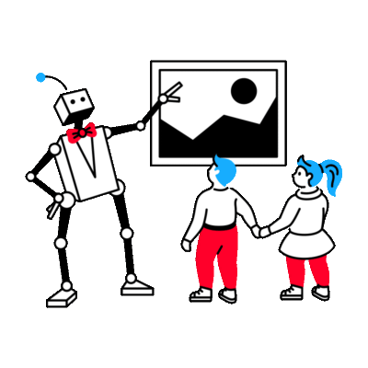
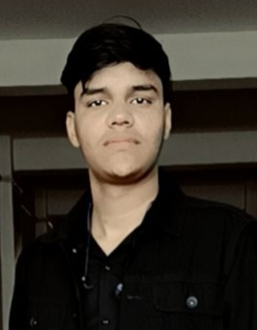
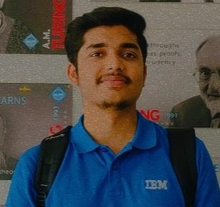
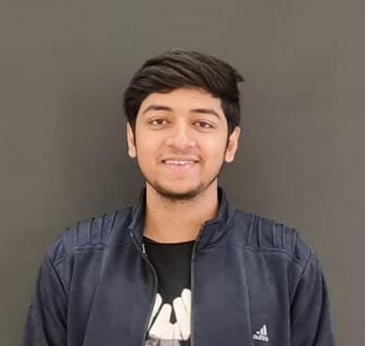
AGE AND GENDER DETECTION
Supervision by: Shashi Shekhar
Vishal
Sharma
Laxmi Narayan
Singh
Shivanand
Pandey

Slide 2



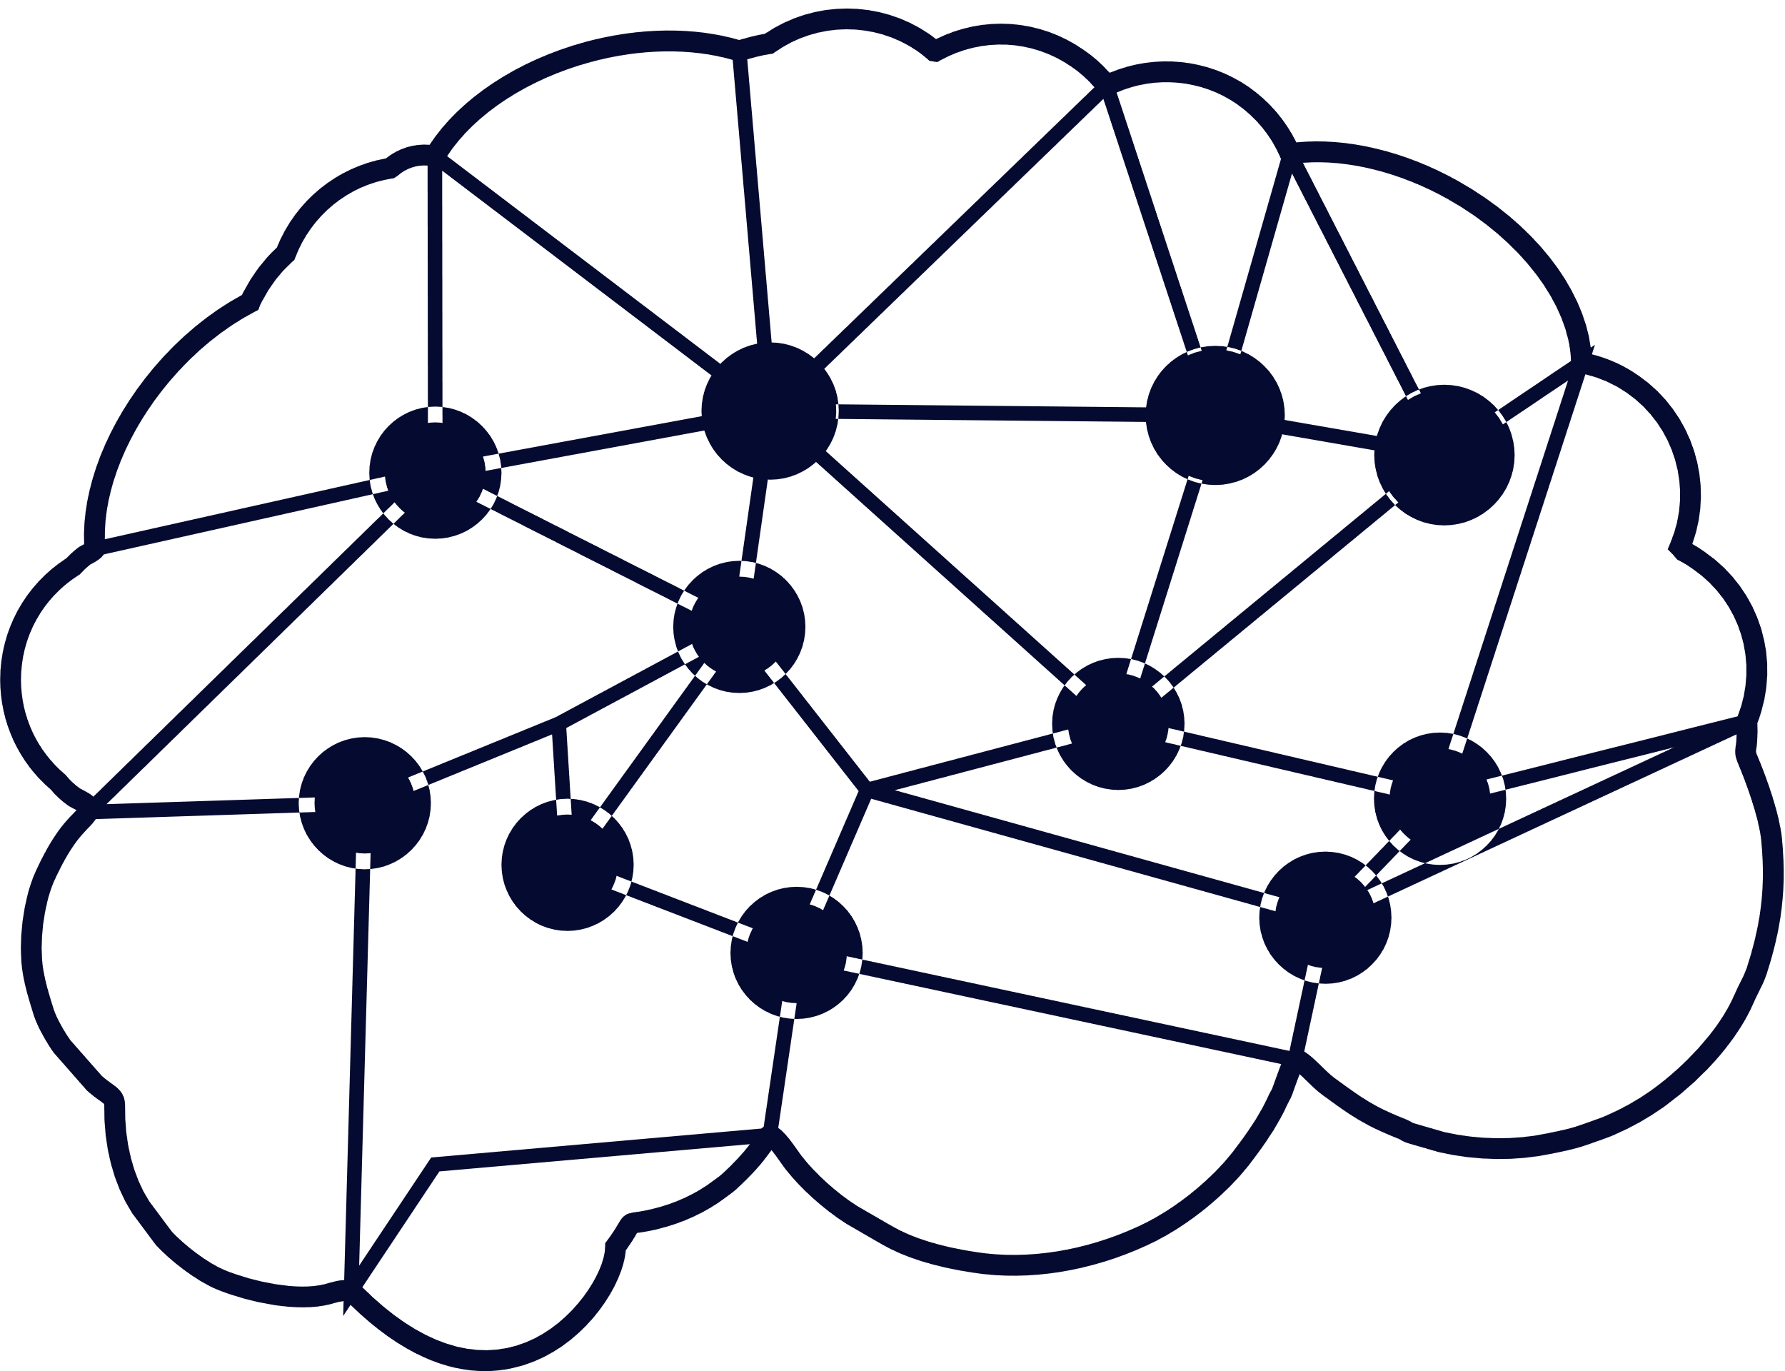
Table of Contents
01
Abstract
04
Flow Chart
02
05
Introduction
Procedures
03
06
Conclusion & Future Work
Technologies Used
07
References

Slide 3




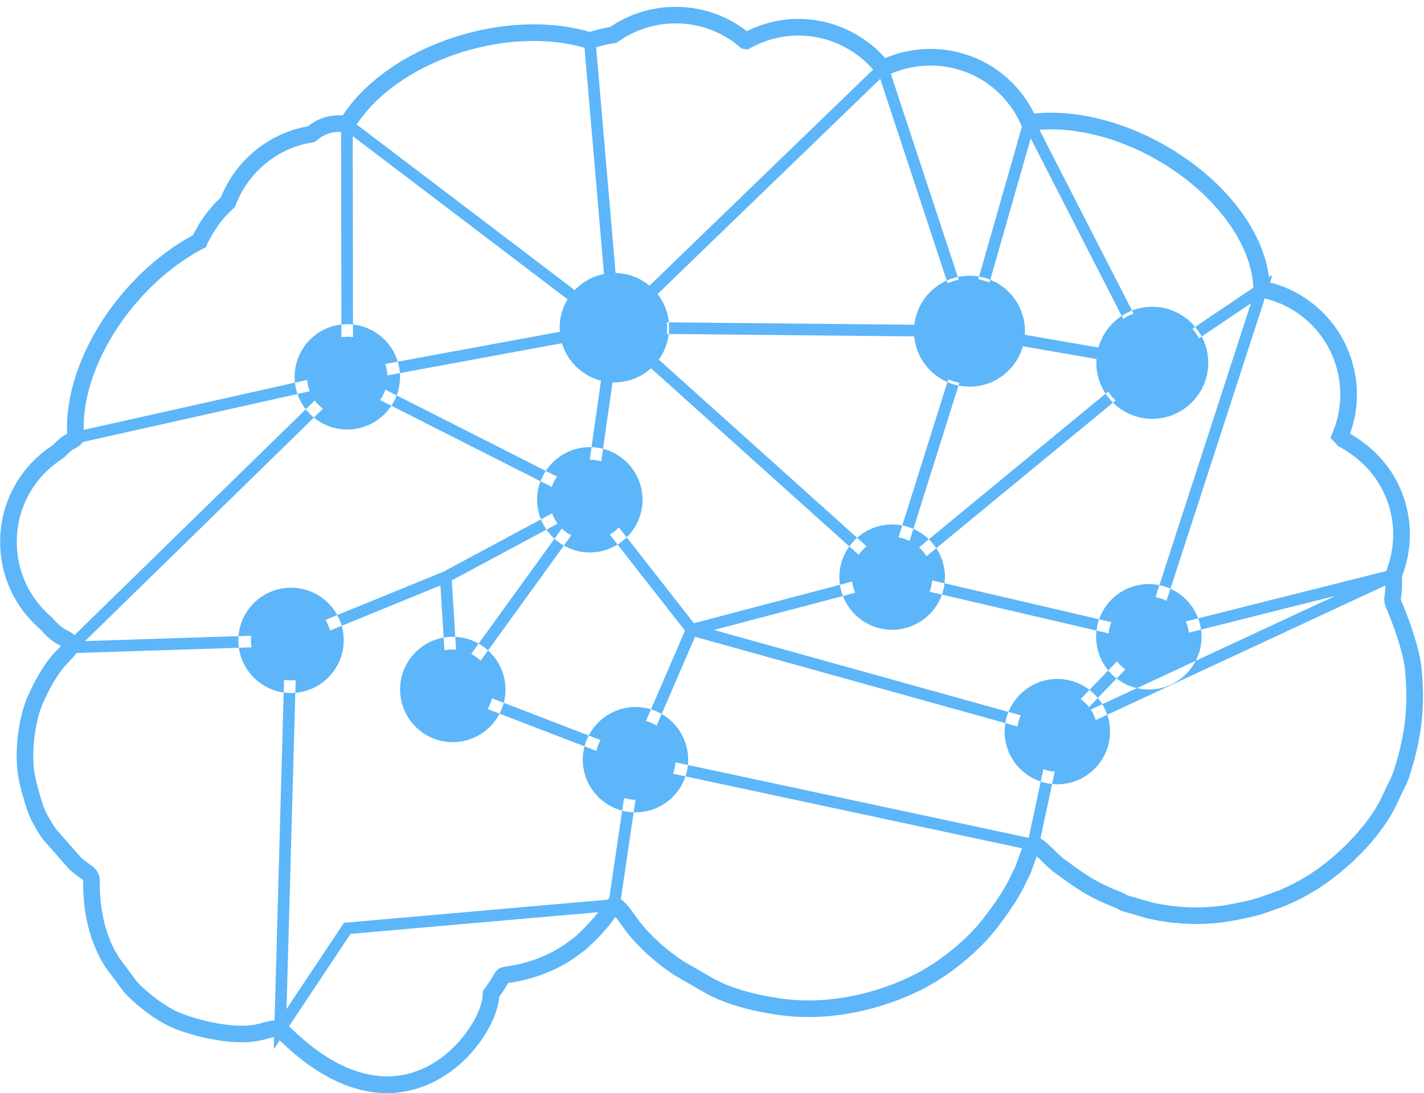

Introduction
• Age and gender, two of the key facial attributes, play a very foundational role in social interactions, making age and gender estimation from a single face frame is an important task in intelligent applications, such as access control, human computer interaction, law enforcement, marketing intelligence and visual surveillance, etc.
In this project, a frame is taken as input and the algorithm will determine the age and gender of person(s) in the frame.

Slide 4
Objective
To pretrain the age and gender detection model using the public Datasets such as UTK Face.
To use facial images to detect the age and gender provided to the model To use model and expose it in as API using Flask or other.
We divide the age into 8 ranges[ (0 - 2), (4 - 6),
(8-12), (15-20), (25 - 32), (38-43), (48 - 53), (60 - 100)]

Slide 5


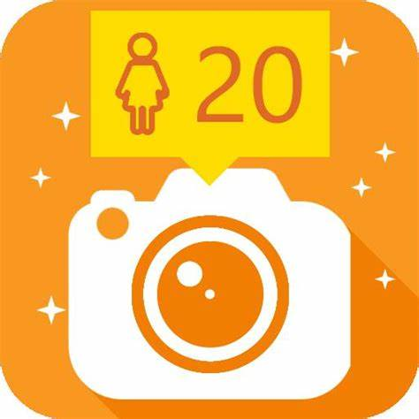

Uses of Topic in Real Life Scenario
Quividi
Age Bot
which is used to detect age and gender of users who passes by based on online face analyses and automatically starts playing advertisements based on the targeted audience.
which is an Android App that determines your age from your photos using facial recognition. It can guess your age and gender along with that can also find multiple faces in a picture and estimate the age for each face.

Slide 6




Dataset Used
UTK Face dataset is a large-scale face dataset with long age span (range from 0 to 116 years old). It has a total of 23708 images. The images cover large variations in facial expression, illumination, pose, resolution and occlusion.
We used the same set of images for training, testing and validation, to have standardized results.

Slide 7
Data Preprocessing
Gray Scale Conversion
Resizing
Storing in NumPy array
Normalizing

Slide 8
Technologies Used
1.Open CV
OpenCV is Open Source Computer vision. This library is capable of processing real-time frame and video while also boasting analytical capabilities. OpenCV is used to display text on the picture using put Text(). I show is used for the frame output. The cv2.dnn. Blob From frame function returns a blob which is our input frame after mean subtraction, normalizing, and channel swapping..
Features of Open CV Library:
•Read and write frames
•Capture and save videos
•Process frames (Filter, transform)
•Perform feature detection
•Detect specific objects such as faces, eyes, cars, in the videos or frames

Slide 9
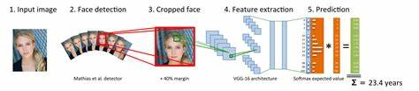
2. CONVOLUTIONAL NEURAL NETWORKS(CNN)
A Convolutional Neural Network is a deep neural network (DNN) widely used for the purposes of frame recognition and processing and NLP. Also known as a ConvNet, a CNN has input and output layers, and multiple hidden layers, many of which are convolutional. In a way, CNNs are regularized multilayer perceptions.

Slide 10
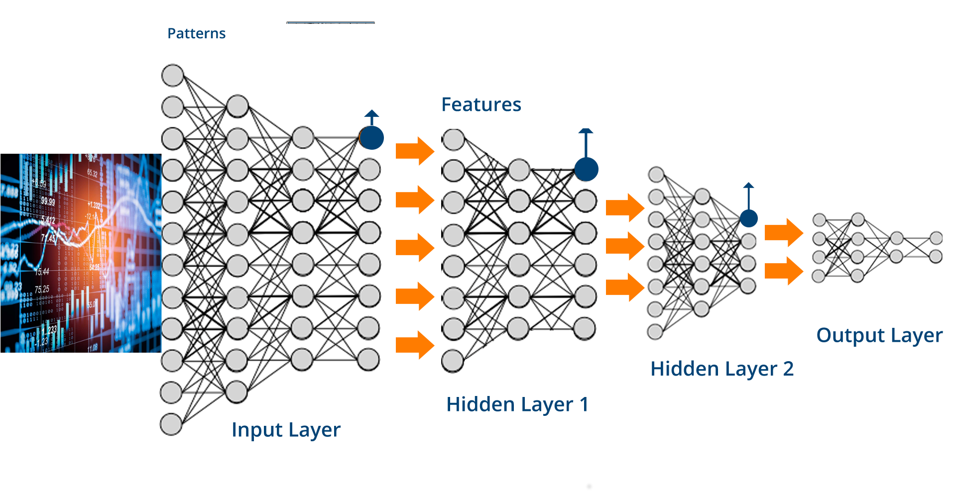
3.Tensor Flow
TensorFlow allows developers to create dataflow graphs-structures that describe how data moves through a graph, or a series of processing nodes.

Slide 11

Proposed Methodology
Load the Dataset
Train-Test Split
Data pre-processing
Building CNN
Test and Deployment

Slide 12
Discussion on Proposed Methodology
Select
Input
Nose
Eyes
Calculate
Eigen Values
Few feature and
Key Points
Find all
Key
feature
Age
Parameter
Final

Slide 13

What Others have done in this area
Literature Reviews
International Journal of Computer Science
Trends and Technology
International Conference of Cloud Computing Data Science & Engineering
Published Year: August,2020
Published Year:2021
Data Set Used : UP Students Dataset.
Proposed Methods : The main goal of this paper is an attempt to propose a form validation role that can be linking between gender, DOB, and user photo inputs and validate each of them based on their relationship
Results Parameters with Accuracy : The model has better results by predicting male's faces photos and it was about 89%, and 74% for females.
Future Work : the large and complex model in that trained on more than 500K of person photos then evaluating the estimation accuracy.
Data Set Used : 1 GB file of which consist 26,580 photos of 2,284 individuals
Proposed Methods :To make the security system better
Results Parameters with Accuracy :Tested on 3 situations where the model implemented on the given photo.
2nd:When the image of a minion (a cartoon character) is introduced, the model was unable to detect a human face and displays a message saying 'no face detected'
Future Work : Further on with this Prototype, Deep Learning and convolutional neural networks will be implemented in order to accurately identify the gender and range of the age to which a person belongs to, from a single image of a face.

Slide 14
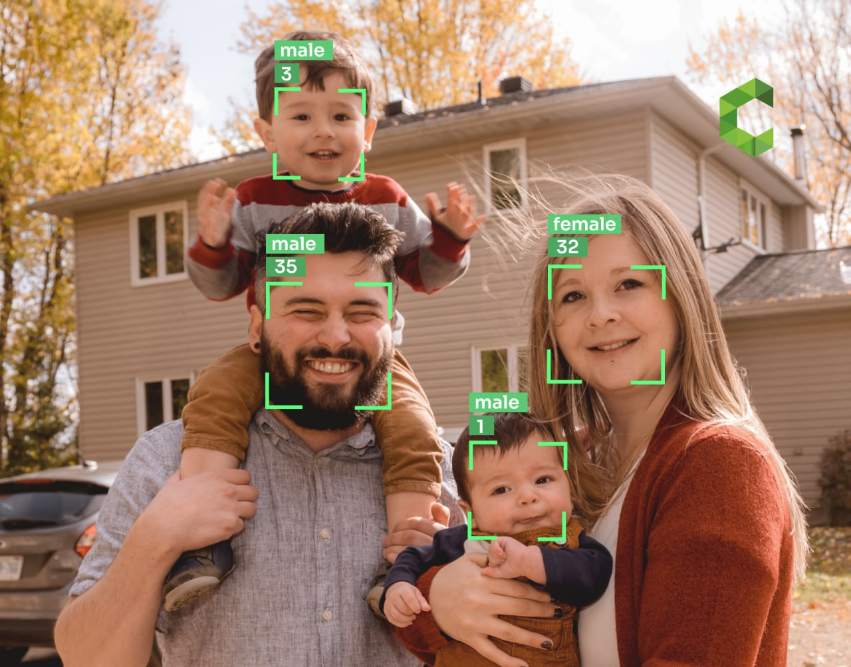
Experiments and Results
Data Set Description with Reference:
UTKFace dataset is a large-scale face dataset with long age span (range from 0 to 116 years old). The dataset consists of over 20,000 face images with annotations of age, gender
https://www.kaggle.com/datasets/jangedoo/utkface-new
System Description: Python 2.7-3.6,Open CV2,PyCharm Community Edition, Webcam (at least 2.0MP)
Discuss the results :
Trained Deep Learning CNN Models, for detecting: ○ Age as: '1-2', '3-9', '10-20', '21-27', '28-45', '46-65', '66-116’
Gender as: 'male', 'female'

Slide 15

References
[1] Reference 1: https://www.kaggle.com/datasets/jangedoo/utkface-new
[2] Reference 2: he IEEE International Conference on Computer Vision, 2015- February, 252–257. https://doi.org/10.1109/ICCVW.2015.41
[3] Reference 3: Research Paper of International Journal of Academic Engineering Research (IJAER) “Age and Gender Prediction and Validation Through Single User Images Using CNN”
[4] Reference 4: Research Article of International Journal of Computer Science Trends and Technology (IJCST) – Volume 5 Issue 4, Jul – Aug 2017
[5] Reference 5: https://ieeexplore.ieee.org/Xplore/home.jsp
[6] Reference 6: https://scholar.google.com/

Slide 16



Any Queries

Slide 17
Thank You

